Slide 1
See the map of the US on the next page. You are only concerned with the states that have numbers listed in them.
Red, Purple, Blue, Green
Using these four colors, color every state with a number in it. No state may touch another state of the same color. Your goal is to get the lowest score possible.
SCORING
Red states x 1 Purple states x 2
Blue states x 3 Green states x 4
Add up all your points

Slide 2
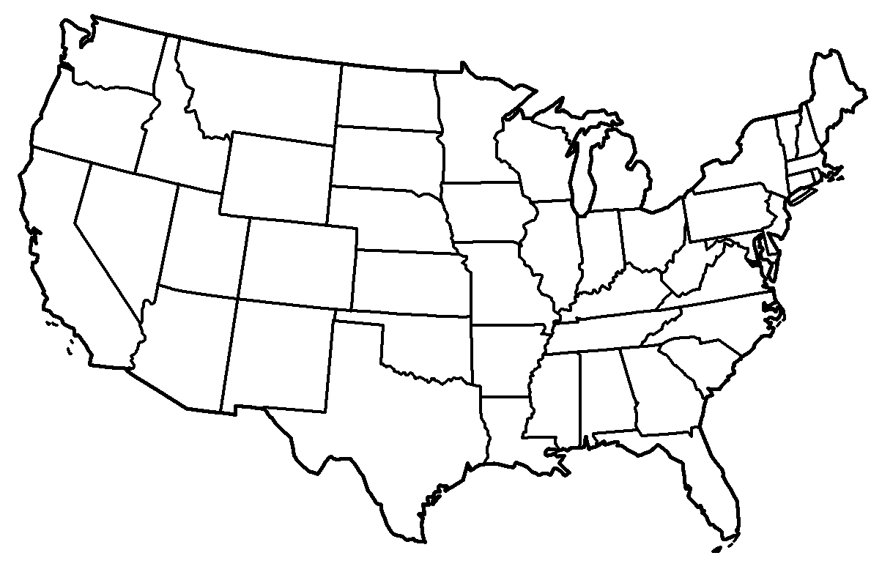
71
147
70
98
86
83
97
77
110
77
56
84
104
163
82
69
113
69
121
53
268
51

